Slide 1
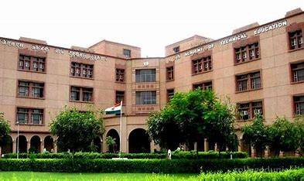

MINI PROJECT IT

Slide 2
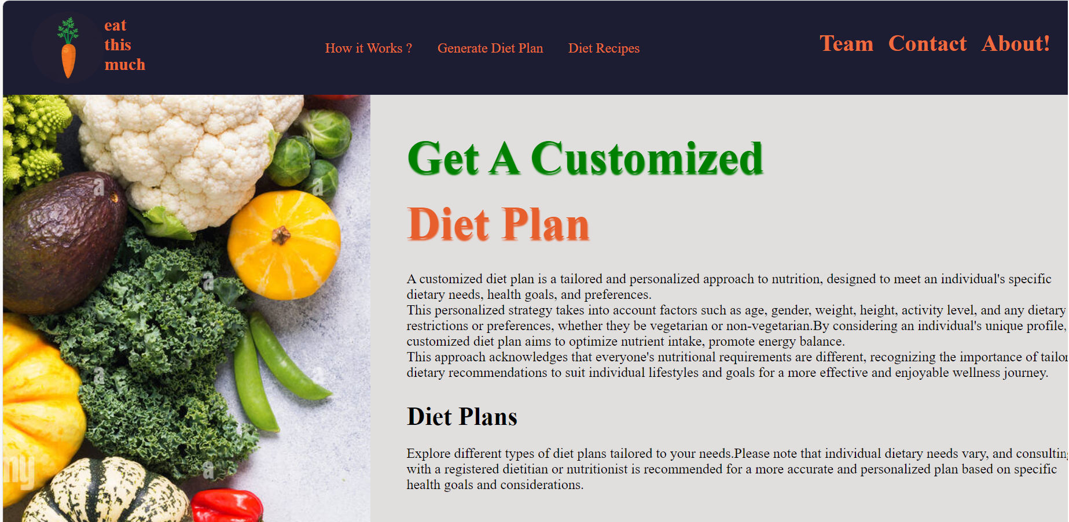
Personalized Diet Chart Generator
Website
Team Members:
Somiya Gupta
(2200910130168)
Varun Saxena
(2200910130188)

Slide 3

Problem Statement
“Many individuals struggle with maintaining a healthy lifestyle due to the challenge of balancing work commitments and limited access to nutrients food options,leading to an increased risk of chronic diseases and overall diminished well-being”.

Slide 4

About
We have made a Personalized Diet chart Generator using HTML, CSS , JavaScript.
Generally, We have seen a lot of problems regarding health.
Now, We are here with the solution.

Slide 5
Diet Plan
Diet Recipe
STAY HEALTHY
Healthy LifeStyle Exercise
Type of Blood Disease
Here you can Generate your Diet Plan , BMI, and Type of Category you live. (Under Weight, Normal Weight, Obese)
Here You can generate which type of recipe you have to follow to become Fit.
In this section, you can see the live YouTube video play of healthy lifestyle exercises.
In this part you can find which type of blood disease is present in your blood.

Slide 6
HOW APPLICATION LOOKS
Website Tour

Slide 7
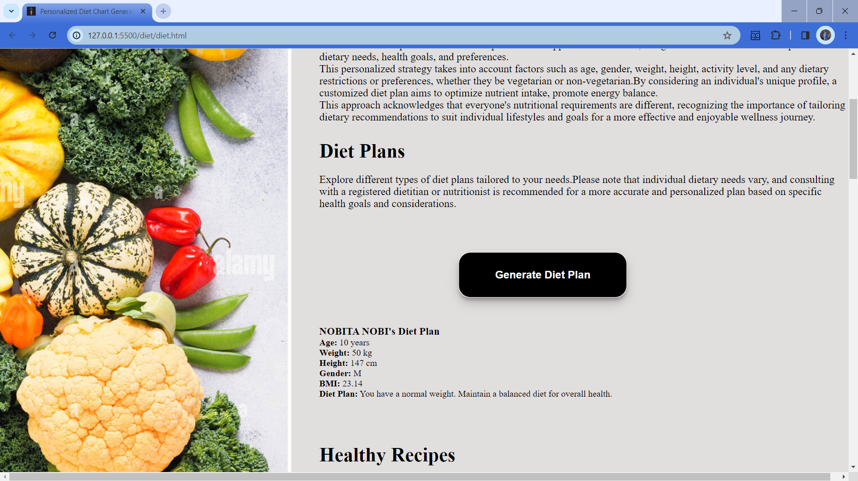
OUR ACADEMIC IDEAS

Slide 8
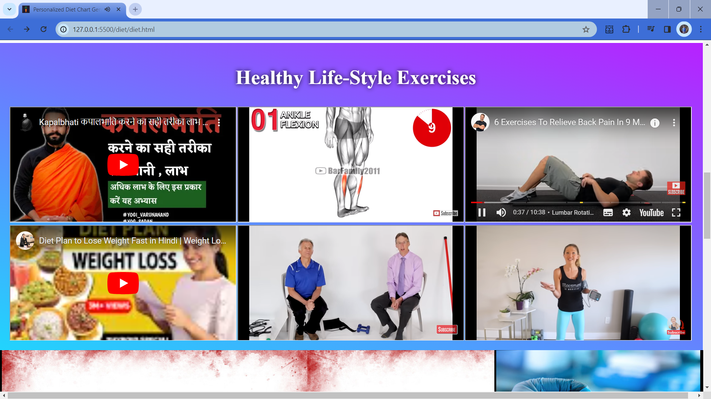
OUR ACADEMIC IDEAS

Slide 9
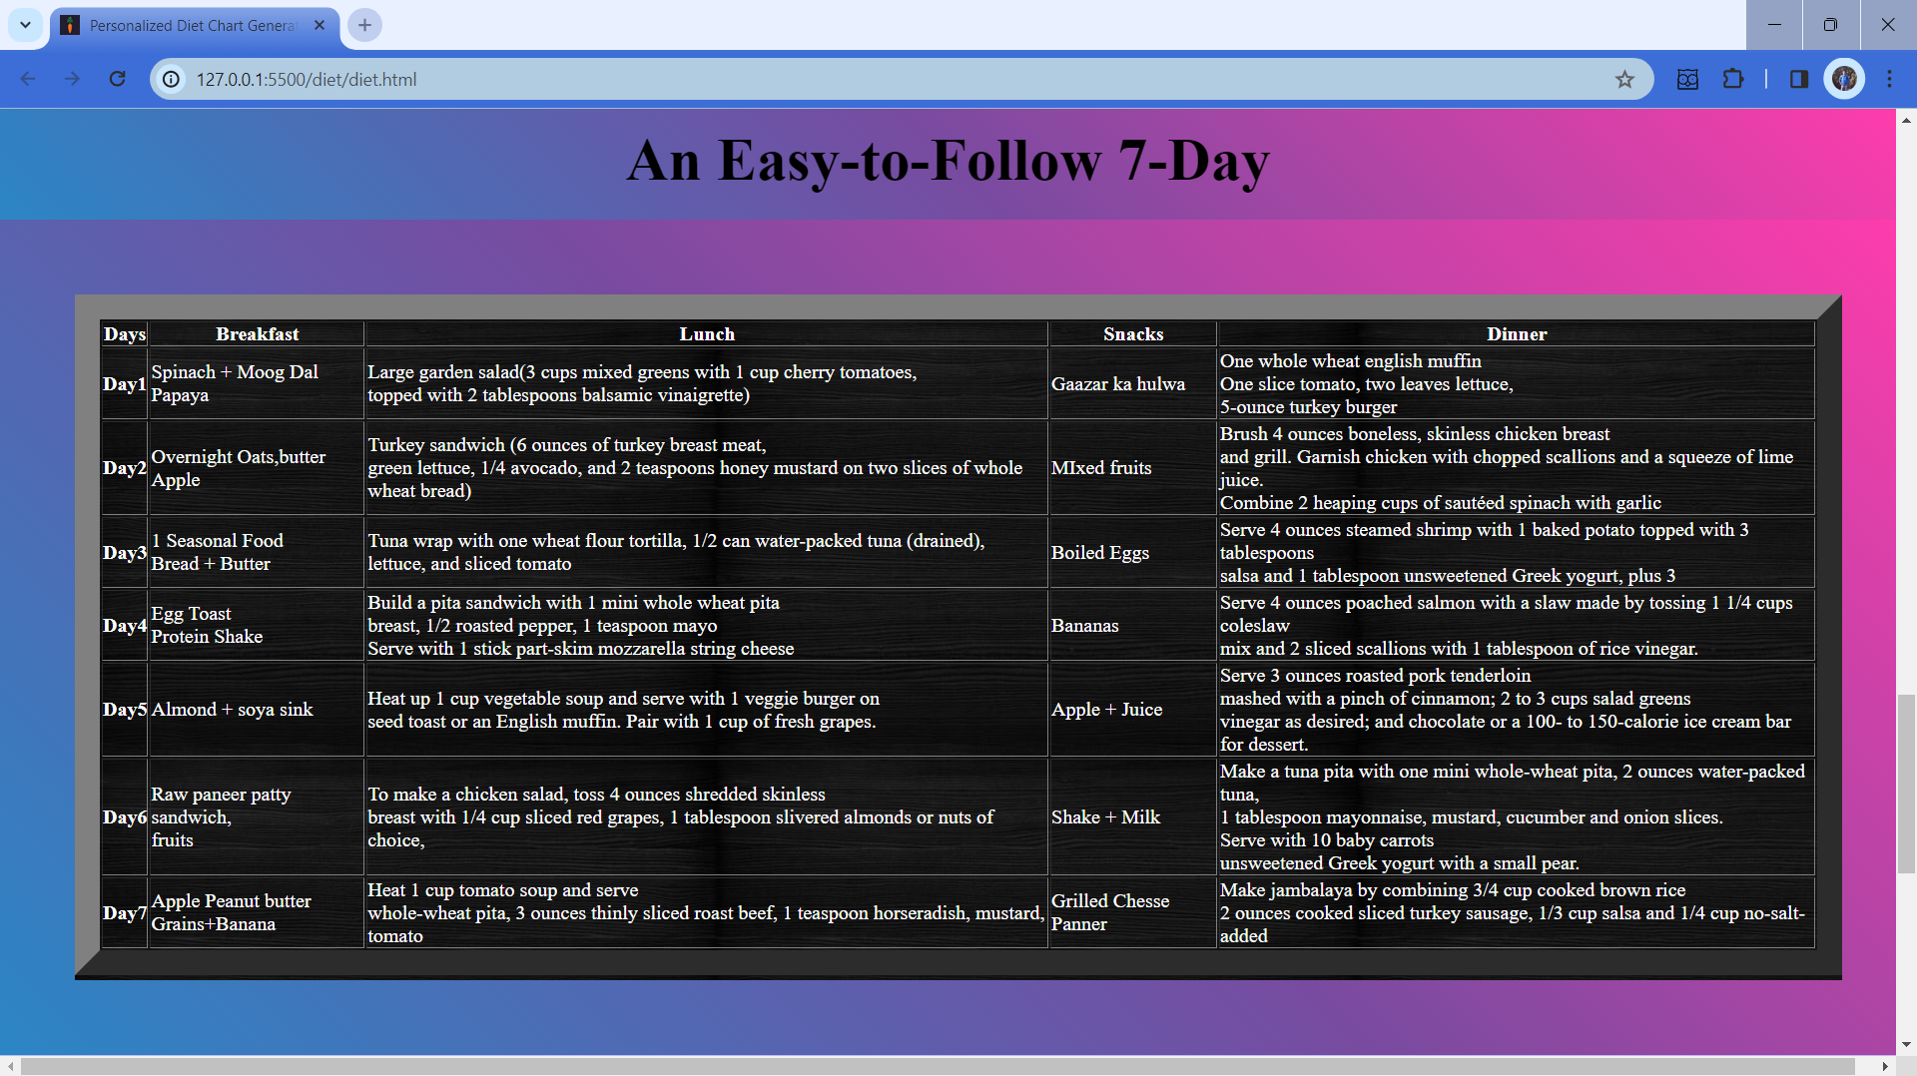
OUR ACADEMIC IDEAS

Slide 10
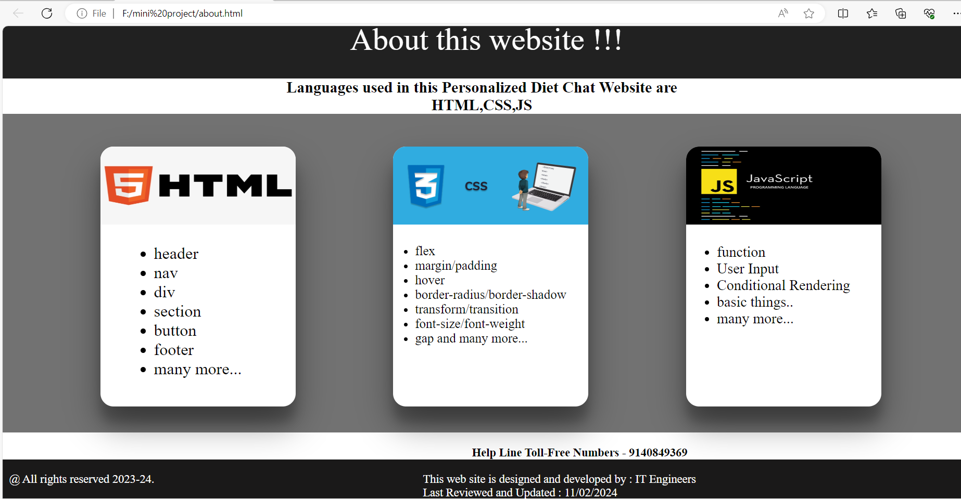
OUR ACADEMIC IDEAS

Slide 11
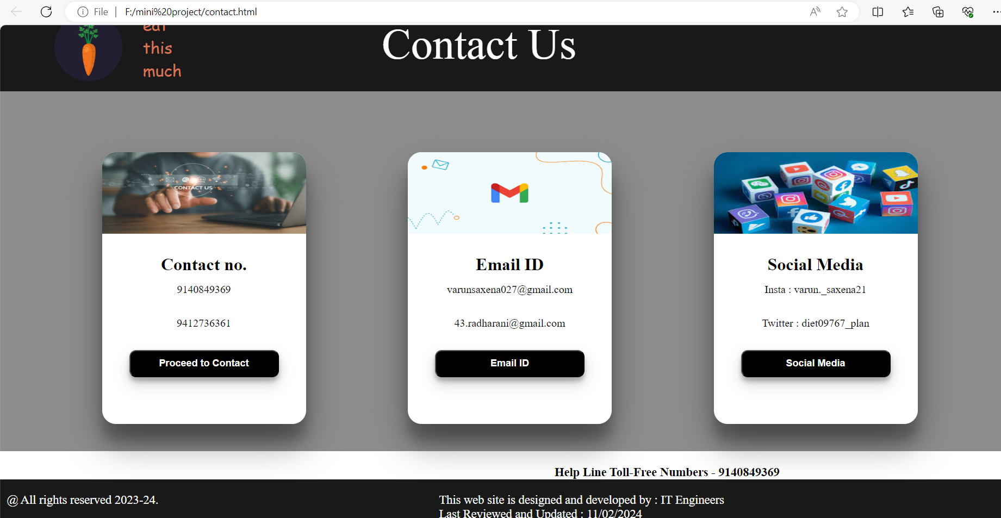
OUR ACADEMIC IDEAS

Slide 12
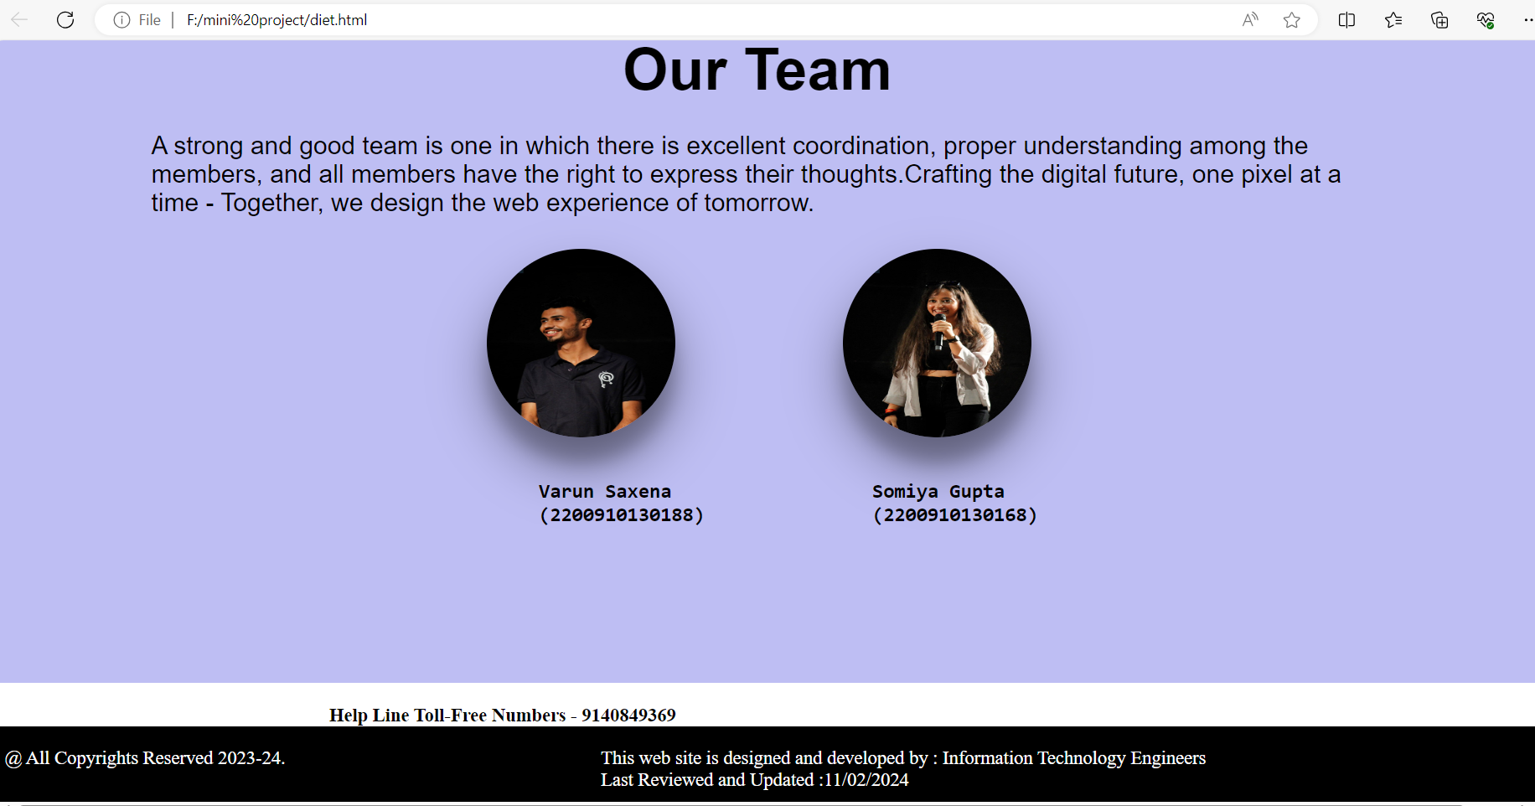
OUR ACADEMIC IDEAS

Slide 13
CONCLUSION
In conclusion, the development of the Personalized Diet Chart Generator Website has been a rewarding learning experience that has equipped us with valuable skills in web development and problem-solving. Moving forward, there is immense potential for further enhancement and expansion of the project.

Slide 14
REFERENCES
[1] J. Krause. Design Basics Index. Cincinnati. OH: How Books. 2004.
[2] J. Duckett. HTML and CSS: Design and Build Website. John Wiley & Sons. 2011.
[3] E. Meyer. CSS: The Definitive Guide. O'Reilly Media. 2017.
[4] D. Flanagan. JavaScript: The Good Parts. O'Reilly Media. 2008.
[5] R. Bringhurst. The Elements of Typographic Style. Vancouver. BC: Hartley & Marks. 2004.
[6] J. Doe and A. Smith. Web Design Trends: A Comprehensive Review. vol. 10. no. 3. pp. 123-135. 2018.

Slide 15

Thank You!
Stay Healthy

